Slide 1
Hack for Health (Hackathon From GeekForGeeks)
Project Title:
Quick Health Analyser
Contributor Name:
Vinay Kumar
Abhay Swarnakar

Slide 2
Overview
Problem Statement
Introduction
Technology used
UI/UX
Feature Improvement
Conclusion
Reference

Slide 3
Problem Statement
In short, using machine learning into early illness detection efforts represents a paradigm change in healthcare. We want to transform diagnostic capabilities, empower healthcare practitioners, and, eventually, improve the quality of life for people throughout the world by using the power of powerful algorithms.

Slide 4
Introduction
In a transformative shift for healthcare, integrating machine learning into early illness detection heralds a paradigm change. Our mission is to revolutionize diagnostic capabilities, empower healthcare practitioners, and enhance global quality of life. Harnessing the potency of advanced algorithms, we aim to usher in a new era of proactive health management for individuals worldwide.

Slide 5
Focused Diseases
We are Focused now Only following type of Disease Detection
Heart Disease
Diabetes Disease
Parkinson’s Disease

Slide 6

Heart Disease
Coronary Artery Disease (CAD): Blockage or narrowing of coronary arteries, reducing blood flow to the heart.
Heart Failure: Heart's inability to pump blood effectively, leading to fatigue and breathlessness.
Arrhythmias: Irregular heartbeats affecting the heart's pumping function.

Slide 7
Heart Disease
Valvular Heart Diseases: Issues with heart valves causing narrowing or leakage.
Hypertensive Heart Disease: Result of prolonged high blood pressure, contributing to heart-related complications.

Slide 8
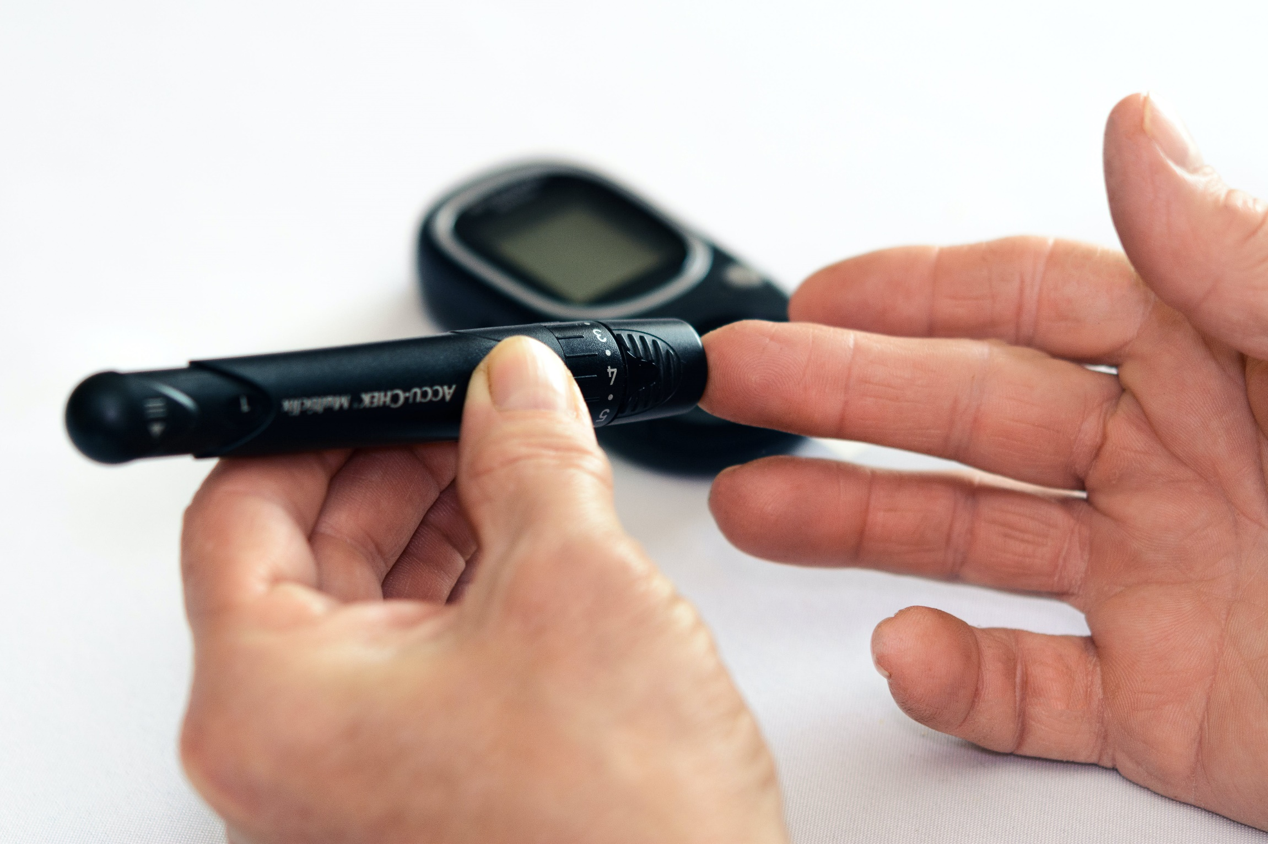
Diabetes Disease
Insulin Imbalance: Diabetes results from insufficient insulin production or ineffective use of insulin in the body.
Hyperglycemia: Elevated blood sugar levels characterize diabetes, leading to various complications if not managed.
Type 1 and Type 2: Two main types exist—Type 1, an autoimmune condition, and Type 2, often linked to lifestyle and genetics.
Complications: Untreated diabetes can cause cardiovascular issues, nerve damage, kidney problems, and other serious health complications.

Slide 9

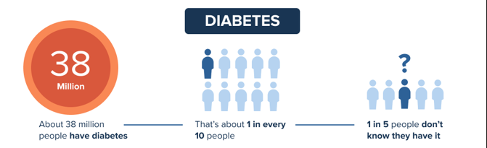
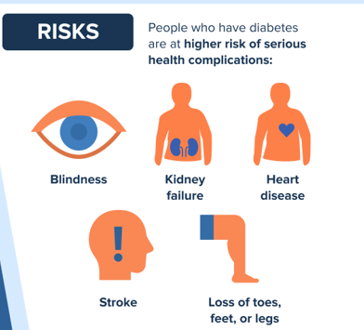
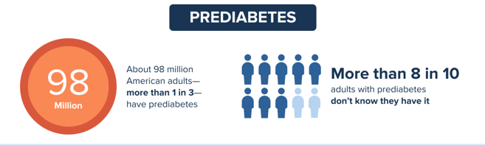
Diabetes Disease

Slide 10
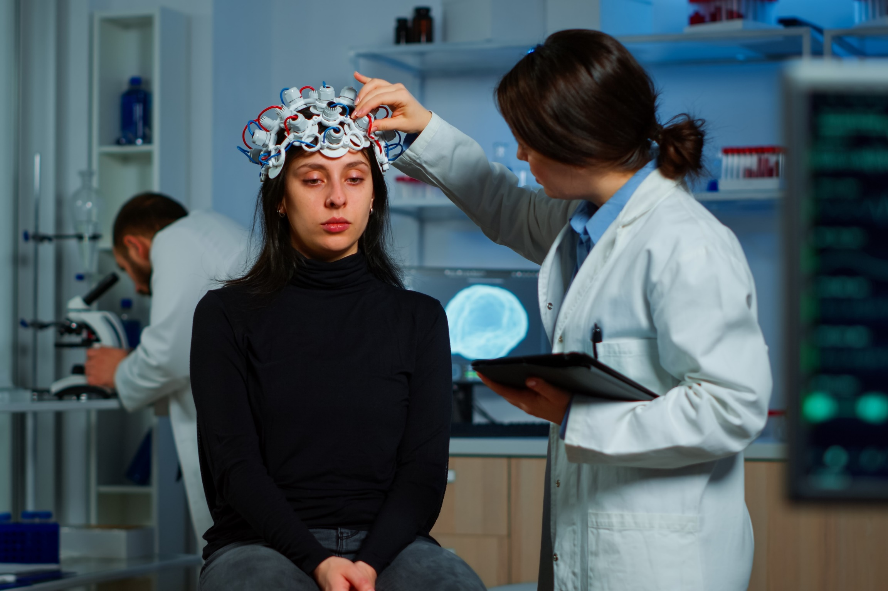
Neurological Disease (Parkinson )
Symptoms: P.D cause motors Symptoms
Slow Movement
Tremor
Painful Muscle
Difficulty Speaking
Imbalance
Note : This dataset is composed of a range of Biomedical Voice Measurements from 31 people, 23 with Parkinson’s Disease(PD).Our Dataset includes voice attributes information that can be used for Detecting Parkinson

Slide 11
Neurological Disease (Parkinson )
Symptoms: Non-Motor
Mental Health Disorder
Dementia
Pain
Sleep Disorder
Sensory Disturbance's
Note : This dataset is composed of a range of Biomedical Voice Measurements from 31 people, 23 with Parkinson’s Disease(PD).Our Dataset includes voice attributes information that can be used for Detecting Parkinson

Slide 12
Neurological Disease (Parkinson )
After 2011, various method we use detected Parkinson’s Disease
Wearable Technology
Voice and Speech Analysis
Imaging Techniques
Biological Marker
Note : This dataset is composed of a range of Biomedical Voice Measurements from 31 people, 23 with Parkinson’s Disease(PD).Our Dataset includes voice attributes information that can be used for Detecting Parkinson

Slide 13
Technology Used
Frontend
HTML,CSS, JS,
React.Js
Backend
Python, Scikit-Learn, Pandas,
Numpy, FastAPI, JSON,
Pickle

Slide 14
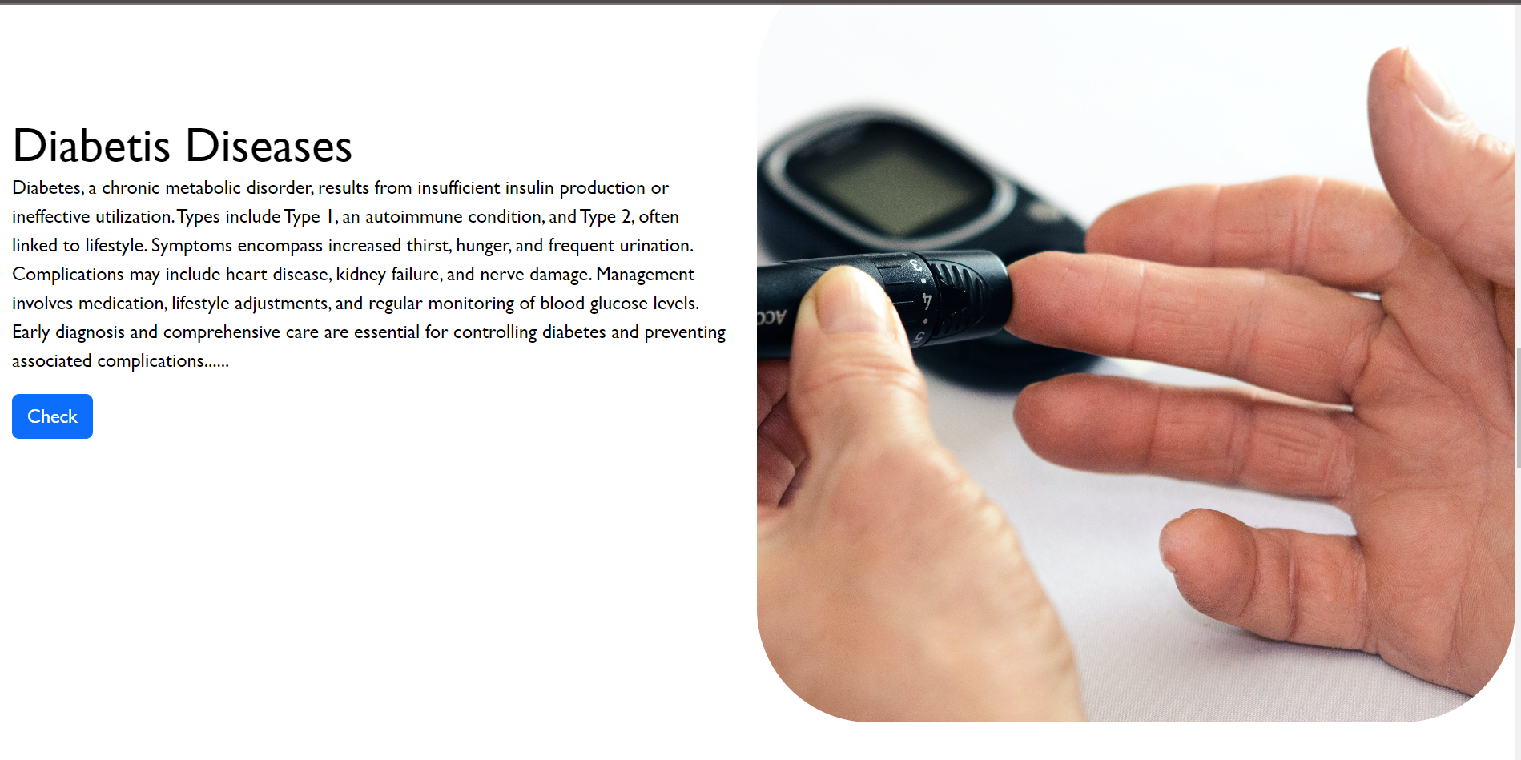
UI/UX

Slide 15
Conclusion
The integration of machine learning into early illness detection epitomizes a paradigm shift in healthcare. It seeks to revolutionize diagnostic capabilities, empower healthcare practitioners, and ultimately elevate the quality of life on a global scale.
As we navigate this transformative journey, a commitment to ethical practices and collaborative endeavors will be instrumental in realizing the full potential of machine learning in healthcare.

Slide 16
Reference
AI/ML Algorithms for Early Disease Detection and Diagnosis
(binariks.com)https://www.kaggle.com/datasets/uciml/pima-indians-diabetes-database
https://www.kaggle.com/datasets/naveenkumar20bps1137/parkinsons-disease-detection/data
https://www.kaggle.com/datasets/johnsmith88/heart-disease-dataset
https://archive.ics.uci.edu/dataset/45/heart+disease

Slide 17
Thank you

